Slide 1
Good day!
Nice to meet you!

Slide 2
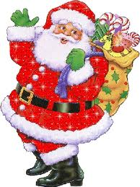
Santa Claus

Slide 3


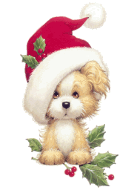
What time is it?

Slide 4
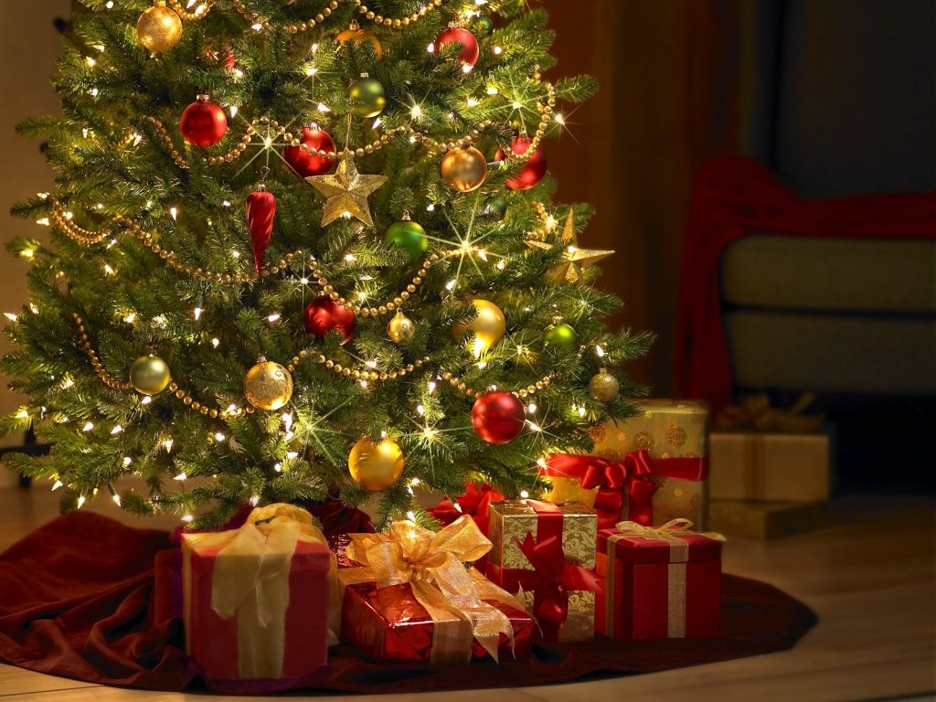
Christmas!

Slide 5
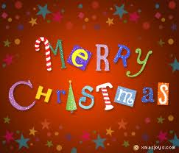
Merry Christmas!

Slide 6
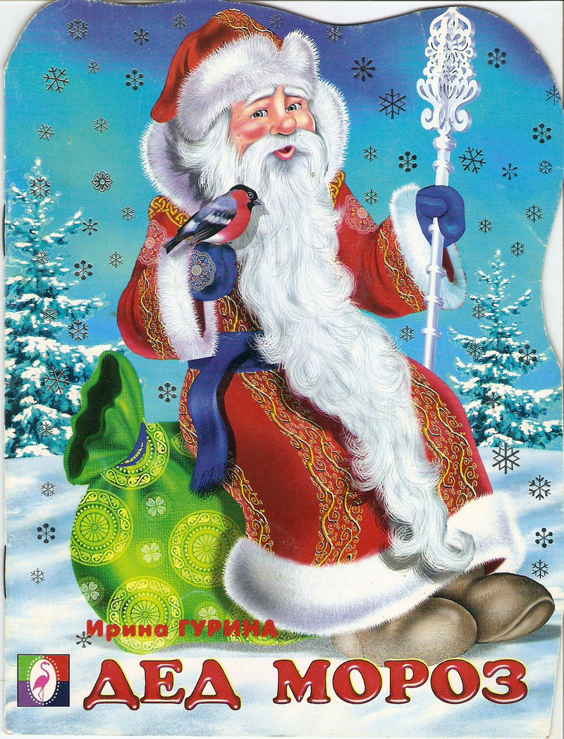
Santa Claus Farther Frost

Slide 7

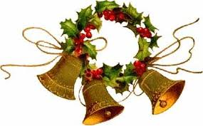
Jingle bells!
Jingle bells!
Jingle bells!
Jingle all the way!

Slide 8
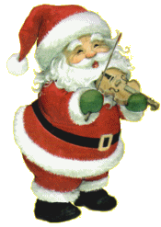

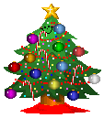

A fire place
Decorations
A star
Santa Claus
Christmas Tree
Stockings
Gifts and Presents

Slide 9
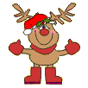

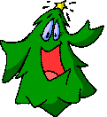

Slide 10





























Guess a puzzle. It is a traditional food
for this holiday.
Here is a key for you and words in code.
A-
B-
C-
D-
E-
F-
G-
H-
I-
J-
K-
L-
M-
N-
O-
P-
Q-
R-
S-
T-
U-
V-
W-
X-
Y-
Z-

Slide 11




The traditional food:
roast turkey and Christmas pudding

Slide 12



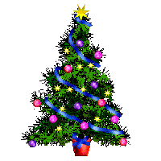
Merry Christmas

